Slide 1


LECTURE 6: Peripherals Clock distribution & Multipurpose Clock Generator (MCG)
EMBEDDED SYSTEM COURSE

Slide 2
Learning Goals
Understanding about how the clock signal has been distributed among KL46 SoC
Understanding on how to configure an specific clock signal for given peripheral.,
Understanding on how to configure the PLL and FLL on using internal clock or external clock.
Notes:
Overview on KL46 Clock Modules
Clock distribution
System Oscillator (OSC)
System Integration Module (SIM)
Multipurpose Clock Generator (MCG)
Mode of Operations
MCG Loss Lock Detector
MCG Auto Trim – ATM
Examples

Slide 3
Table of contents
Overview on KL46 Clock Modules
Clock distribution
System Oscillator (OSC)
System Integration Module (SIM)
Multipurpose Clock Generator (MCG)
Mode of Operations
MCG Loss Lock Detector
MCG Auto Trim – ATM
Examples

Slide 4
Table of contents
Overview on KL46 Clock Modules
Clock distribution
System Oscillator (OSC)
System Integration Module (SIM)
Multipurpose Clock Generator (MCG)
Mode of Operations
MCG Loss Lock Detector
MCG Auto Trim – ATM
Examples

Slide 5
Overview on KL46 Clock Modules
The KL46 contains the following modules on maintaining the MCU clock and its power mode:
System Oscillator (OSC): The OSC module is a crystal oscillator. The module, in conjunction with an external crystal or resonator, generates a reference clock for the MCU. Refer chapter 25 in KL46 Reference Manual.
System Integration Module (SIM): Configure the output clock and its divide factory for MCU system clock and other peripherals. Refer chapter 12 in KL46 Reference Manual.
System Mode Controller (SMC): is responsible for sequencing the system into and out of all low-power Stop and Run modes. Refer chapter 13 in KL46 Reference Manual.

Slide 6
Overview on KL46 Clock Modules
The KL46 contains the following modules on maintaining the MCU clock and its power mode:
Multipurpose Clock Generator (MCG): provides several clock source choices for the MCU. The module contains a frequency-locked loop (FLL) and a phase-locked loop (PLL)
Clock distribution diagram: depict all clock lines, PLL and FLL in the system. It also provides the relationship among the MCG, OSC and SIM in the MCU. Refer chapter 5 in KL46 Reference Manual.
In this scope of the lecture, only the Clock distribution, SIM, OSC, MCG have been discussed. The SMC is an advance topic and target on self-studying.

Slide 7
Table of contents
Overview on KL46 Clock Modules
Clock distribution
System Oscillator (OSC)
System Integration Module (SIM)
Multipurpose Clock Generator (MCG)
Mode of Operations
MCG Loss Lock Detector
MCG Auto Trim – ATM
Examples

Slide 8
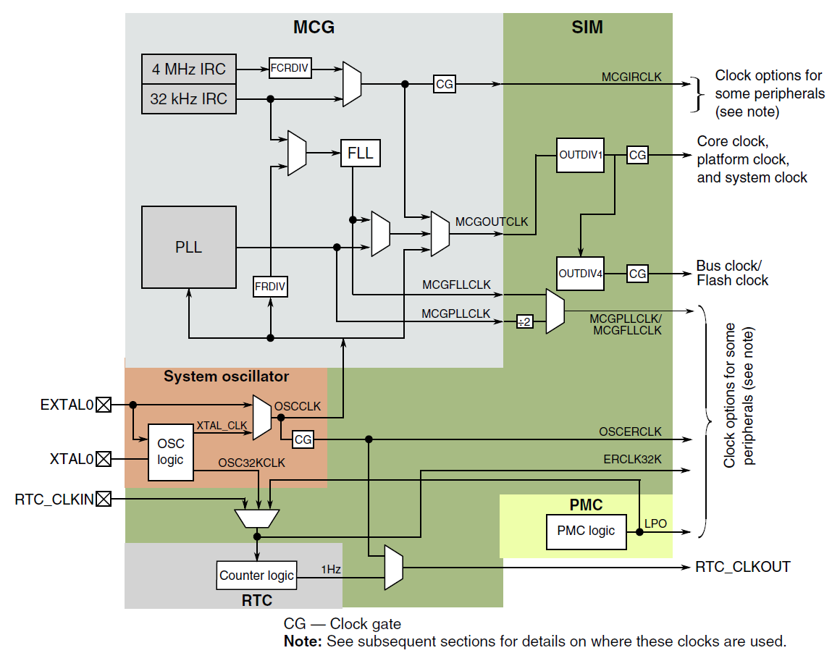
Clock Distribution
Refer KL46 Reference Manual:
Clock Distribution: chapter 5
SMC: chapter 13
Chapter 24
Chapter 12
Chapter 25
Chapter 34
Chapter 14

Slide 9
Clock Distribution
Clock definitions
Clock name | Description
Core clock | MCGOUTCLK divided by OUTDIV1 Clocks the ARM Cortex-M0+ core.
Platform clock | MCGOUTCLK divided by OUTDIV1 Clocks the crossbar switch and NVIC.
System clock | MCGOUTCLK divided by OUTDIV1 Clocks the bus masters directly
Bus clock | System clock divided by OUTDIV4. Clocks the bus slaves and peripherals.
Flash clock | Flash memory clock On this device, it is the same as Bus clock

Slide 10
Clock Distribution
Clock definitions
Clock name | Description
MCGIRCLK | MCG output of the slow or fast internal reference clock
MCGOUTCLK | MCG output of either IRC, MCGFLLCLK, MCGPLLCLK, or MCG's external reference clock that sources the core, system, bus, and flash clock.
MCGFLLCLK, MCGPLLCLK | MCG output of the FLL and PLL
OSCCLK | System oscillator output of the internal oscillator or sourced directly from EXTAL. Used as MCG external reference clock
OSCERCLK | System oscillator output sourced from OSCCLK that may clock some on-chip modules
OSC32KCLK | System oscillator 32kHz output

Slide 11
Clock Distribution
Base on this diagram, to configure:
External clock selection: refer to System Oscillator module in chapter 25
Internal clock source and PLL, FLL: refer to MCG module in chapter 24
Peripheral clock gate and its divide factor: refer to SIM module in chapter 12.

Slide 12
Table of contents
Overview on KL46 Clock Modules
Clock distribution
System Oscillator (OSC)
System Integration Module (SIM)
Multipurpose Clock Generator (MCG)
Mode of Operations
MCG Loss Lock Detector
MCG Auto Trim – ATM
Examples

Slide 13
System Oscillator (OSC)
System Oscillator (OSC)
The module, in conjunction with an external crystal or resonator, generates a reference clock for the MCU
Input:
External Crystal
Input RTC Clock
Output:
OSCCLK for MCU system
OSCERCLK for on-chip peripherals, and OSC32KCLK
OSC32KCLK for RTC

Slide 14
Table of contents
Overview on KL46 Clock Modules
Clock distribution
System Oscillator (OSC)
System Integration Module (SIM)
Multipurpose Clock Generator (MCG)
Mode of Operations
MCG Loss Lock Detector
MCG Auto Trim – ATM
Examples

Slide 15
System Integration Module (SIM)
System Integration Module (SIM)
System clock configuration
System Clock divide values
ERCLK32K clock selection
Peripheral clock gate and selection

Slide 16
Table of contents
Overview on KL46 Clock Modules
Clock distribution
System Oscillator (OSC)
System Integration Module (SIM)
Multipurpose Clock Generator (MCG)
Mode of Operations
MCG Loss Lock Detector
MCG Auto Trim – ATM
Examples

Slide 17
Multipurpose Clock Generator (MCG)
Multipurpose Clock Generator (MCG): provides several clock source choices for the MCU. The module contains a frequency-locked loop (FLL) and a phase-locked loop (PLL)

Slide 18
Multipurpose Clock Generator (MCG)
Key features:
01 Frequency-locked loop (FLL)
Internal or external reference clock can be used as the FLL source
Can be used as a clock source for other on-chip peripherals
01 Phase-locked loop (PLL)
External reference clock is used as the PLL source
Integrated loop filter
Can be used as a clock source for other on-chip peripherals
Internal reference clock generator
Slow clock with nine trim bits for accuracy.
Fast clock with four trim bits
Can be used as source clock for the FLL
Either the slow or the fast clock can be selected as the clock source for the MCU
Can be used as a clock source for other on-chip peripherals
External clock from the Crystal Oscillator (OSC0): can be used as a source for FLL and/or PLL. Also can provide clock to MCU
External clock from the Crystal Oscillator (OSC1): can be used as a source for PLL. Also can provide clock to MCU
External clock from the Real Time Counter (RTC): clock source for FLL. Also can provide clock to MCU
External clock monitor with reset and interrupt request
Internal Reference Clocks Auto Trim Machine (ATM) capability using an external clock as a reference

Slide 19
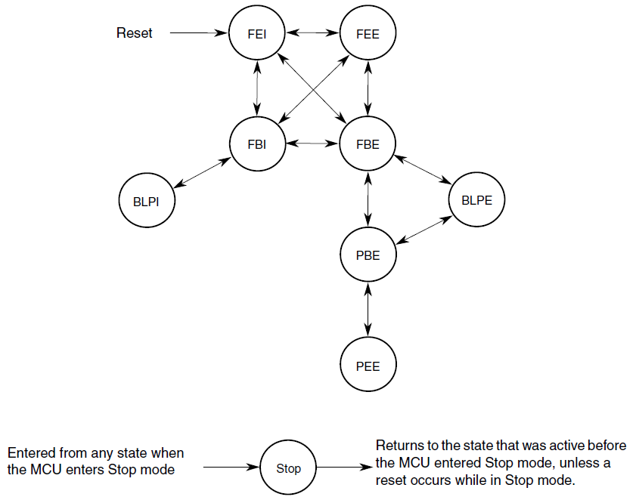
Multipurpose Clock Generator (MCG)
Mode of Operations
FEI : FLL Engaged Internal
FEE: FLL Engaged External
FBI: FLL Bypassed Internal
FBE: FLL Bypassed External
PEE: PLL Engaged External
PBE: PLL Bypassed External
BLPI: Bypassed Low Power Internal
BLPE: Bypassed Low Power External
STOP

Slide 20
Multipurpose Clock Generator (MCG)
Mode of Operations
FEI : FLL Engaged Internal
Default mode of operation
Selects the FLL output as the MCGOUT clock
Multiplies the Slow Internal Reference Clock
PLL is disabled in a low-power state unless C5[PLLCLKEN] is set
Setting: C1[CLKS]=0, C1[IREFS]=1, C6[PLLS]=0

Slide 21
Multipurpose Clock Generator (MCG)
Mode of Operations
FEE : FLL Engaged External
Selects the FLL output as the MCGOUT clock
Multiplies the External Reference Clock
PLL is disabled in a low-power state unless C5[PLLCLKEN] is set
Setting: C1[CLKS] = 00, C1[IREFS] = 0, C6[PLLS] = 0 and C1[FRDIV] set to provide an external ref clock in the range of 31.25 kHz to 39.0625 kHz

Slide 22
Multipurpose Clock Generator (MCG)
Mode of Operations
FBE: FLL Bypassed External
Selects the External Reference Clock as the MCGOUT clock.
The FLL is operational but the output is not used (external reference clock is used as the input reference)
Can be provide a system clock by when FLL archived the target frequency.
PLL is disabled in a low-power state unless C5[PLLCLKEN] is set
Setting: C1[CLKS] = 10, C1[IREFS] = 0, C1[FRDIV] set to provide an external ref clock in the range of 31.25 kHz to 39.0625 kHz, C6[PLLS] = 0 and C2[LP] = 0

Slide 23
Multipurpose Clock Generator (MCG)
Mode of Operations
PEE: PLL Engaged External
Selects the PLL output as the MCGOUT clock
The external reference clock provides the PLL reference clock
Setting: C1[CLKS] = 00, C1[IREFS] = 0, C5[PRDIV] set to provide an external ref clock in the range of 2 MHz to 4 MHz and C6[PLLS] = 1 and C2[LP] = 0
FLL is disabled in a lowpower state.

Slide 24
Multipurpose Clock Generator (MCG)
Mode of Operations
PBE: PLL Bypassed External
Selects the External Reference Clock as the MCGOUT clock.
The PLL is operational but the output is not used (external reference clock is used as the input reference)
This mode can be used to provide a system clock while the PLL achieves the target frequency
Setting: C1[CLKS] = 10, C1[IREFS] = 0, C5[PRDIV] set to provide an external ref clock in the range of 2 MHz to 4 MHz, C6[PLLS] = 1 and C2[LP] = 0
FLL is disabled in a lowpower state.

Slide 25
Multipurpose Clock Generator (MCG)
Mode of Operations
BLPI: Bypassed Low Power Internal
Can select slow or fast Internal Reference Clock as the MCGOUT clock
The FLL and PLL are disabled (even if PLLCLKEN set)
Setting: C1[CLKS] = 01, C1[IREFS] = 1, C6[PLLS] = 0 and C2[LP] = 1

Slide 26
Multipurpose Clock Generator (MCG)
Mode of Operations
BLPE: Bypassed Low Power External
External Reference Clock as the MCGOUT clock
The FLL and PLL are disabled (even if PLLCLKEN set)
Setting: C1[CLKS] = 10, C1[IREFS] = 0 and C2[LP] = 1

Slide 27
Multipurpose Clock Generator (MCG)
Mode of Operations
STOP
MCGPLLCLK is active in Normal Stop mode when PLLSTEN=1
MCGPLL1CLK is active in Normal Stop mode when PLLSTEN1=1
MCGIRCLK is active in Normal Stop mode when all the following conditions become true:
C1[IRCLKEN] = 1
C1[IREFSTEN] = 1

Slide 28
Multipurpose Clock Generator (MCG)
MCG Loss Lock Detector
The MCG includes a PLL loss-of-lock detector – the MCU has been reset if the phase lock gets lost.
The detector is enabled when configured for PEE and lock has been achieved.
If the MCG_C8[LOLRE] bit in the MCG module is set and the PLL lock status bit (MCG_S[LOLS0]) becomes set, the MCU resets. The RCM_SRS0[LOL] bit is set to indicate this reset source.

Slide 29
Multipurpose Clock Generator (MCG)
MCG Auto Trim – ATM
An feature enable the MCG hardware to automatically trim the MCG Internal Reference Clocks using an external clock as a reference.
The selection between which MCG IRC clock gets tested and enabled is controlled by the ATC[ATMS] control bit
(ATC[ATMS]=0 selects the 32 kHz IRC and ATC[ATMS]=1 selects the 4 MHz IRC).
If 4 MHz IRC is selected for the ATM, a divide by 128 is enabled to divide down the 4 MHz IRC to a range of 31.250 kHz.

Slide 30
Table of contents
Overview on KL46 Clock Modules
Clock distribution
System Oscillator (OSC)
System Integration Module (SIM)
Multipurpose Clock Generator (MCG)
Mode of Operations
MCG Loss Lock Detector
MCG Auto Trim – ATM
Examples

Slide 31
Multipurpose Clock Generator (MCG)
Examples: FRD KL46 uses external crystal 8MHz, Switching from FEI -> FEE (MCGOUTCLK=Bus clock = 8MHz, FLL output = 20MHz)
Configure OSC0 to use external crystal
Enable clock for PortA: SIM[SCGC5]
Configure the PTA18 and PTA19 to MUX
Select FLL as a clock source
MCG[C2].RANGE0 = 10 – Very high frequency range selected for the crystal oscillator
MCG[C2]. EREFS0 = 1 – Oscillator requested
OSC0[CR]. ERCLKEN = 0 – since we use the crystal instead of external clock reference.
MCG[C1].CLKS = 0x02 - Selects the clock source for MCGOUTCLK to external reference clock
MCG[C1].FRDIV = 0x03 – set input clock to FLL = external ref clock /256 = 31.250KHz
MCG[C1].IREFS = 0x00 – Select input FLL clock is external ref clock
Set MCG[C4].DMX32= 0x00, MCG[C4].DRST_DRS = 0x00 – set FLL factor = 640 -> input FLL ref clock = 31.250Khz * 640 = 20Mhz

Slide 32
Multipurpose Clock Generator (MCG)
Examples
Switching from FEE -> FBE

Slide 33
Multipurpose Clock Generator (MCG)
Examples
Switching from FEE -> PEE

Slide 34
Multipurpose Clock Generator (MCG)
Enable clock for I2C0 module
Configure the MCG to specific mode (i.e. PEE), configure the Bus clock properly (setting OUTDIV4) since the I2C0 is clocking from Bus clock.
Configure the I2C0_SCL and I2C0_SDA pin to I2C mode
Set PTC9 (I2C0_SDA) mode 2: PORTC[PCR9].MUX=0x2
Set PTC8 (I2C0_SCL) to mode 2: PORTC[PCR8].MUX=0x2
Enable the clock gate for I2C0 module
Set SIM_SCGC4[I2C0] = 1
Setting the I2C0_F register to configure its baudrate
Enable the I2C0 module
Set I2C0_C1[IICEN] = 1

Slide 35
Summary
Understanding about the basic concepts regarding KL46 clock modules including clock distribution, how to configure MCG to archives the target clock speed.

Slide 36

Question & Answer
Thanks for your attention !

Slide 37
Copyright
This course including Lecture Presentations, Quiz, Mock Project, Syllabus, Assignments, Answers are copyright by FPT Software Corporation.
This course also uses some information from external sources and non-confidential training document from Freescale, those materials comply with the original source licenses.

